Slide 1


PIZZA SHOP SALES ANALYSIS- SQL
PROJECT BY PABITRA BISWAS

Slide 2


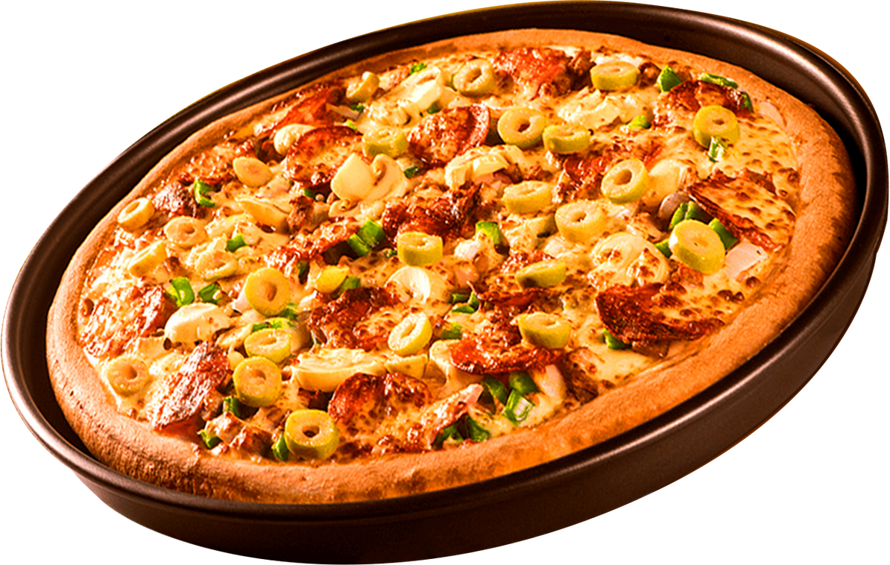


Project Introduction
Overview:
This project analyzes the sales performance of a pizza shop using a SQL queries. It addresses key business questions to reveal insights on orders, revenue, and customer preferences.
Data Schema:
orders: Stores order_id, date, and time
order_details: Contains order_details_id, order_id, pizza_id, and quantity
pizzas: Holds pizza_id, pizza_type_id, price, and size
pizza_types: Includes pizza_type_id, name, category, and ingredients
Database Name: pizzahut
Objective:
Demonstrate the ability to extract actionable insights using SQL and showcase process-driven business analysis.
PPT by Pabitra Biswas

Slide 3


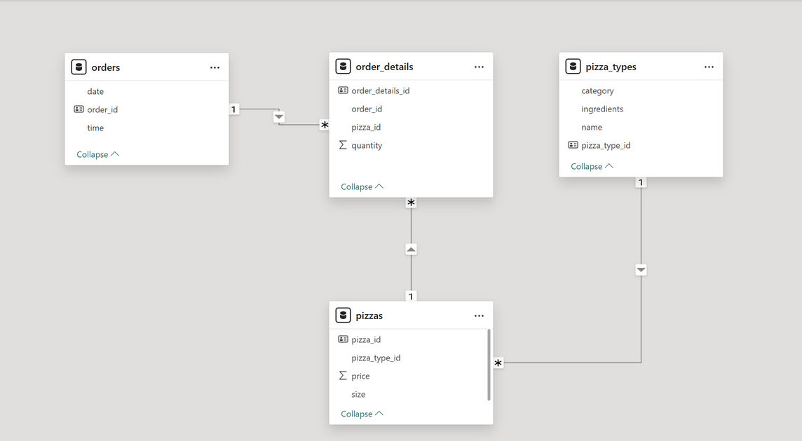
Data Schema Overview
Key Relationships:
orders — linked to order_details via order_id
order_details — linked to pizzas via pizza_id
pizzas — linked to pizza_types via pizza_type_id
PPT by Pabitra Biswas

Slide 4
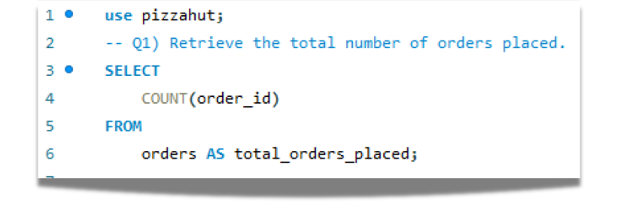
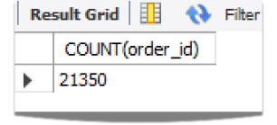
Query 1 – Total Number of Orders Placed
Result Output:
Insight:
Determines the overall order volume which forms the basis for subsequent revenue and pattern analyses.
PPT by Pabitra Biswas

Slide 5
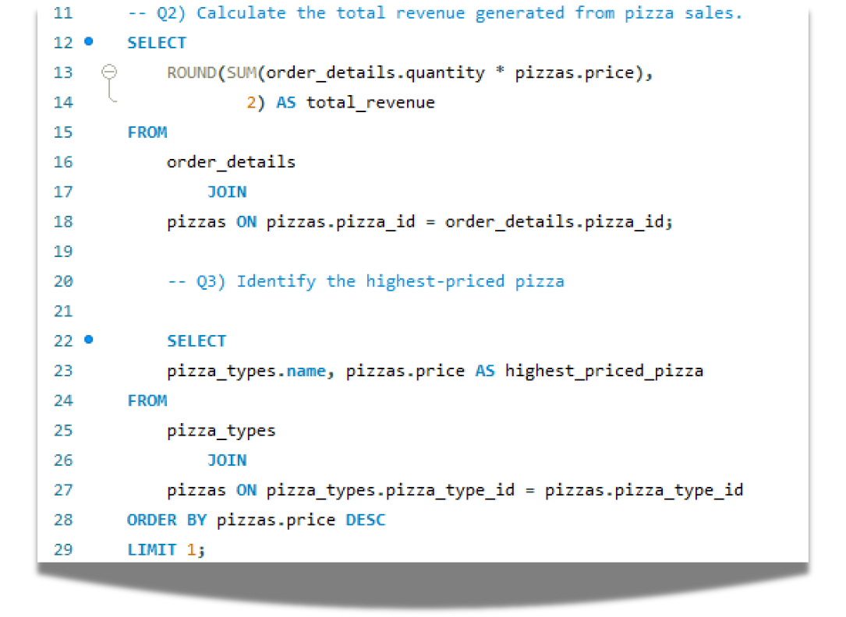
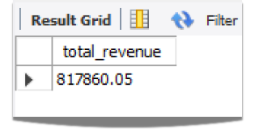
Query 2 – Total Revenue from Pizza Sales
Result Output:
Insight:
Calculates the complete revenue generated across all orders—critical for assessing the shop’s performance.
PPT by Pabitra Biswas

Slide 6
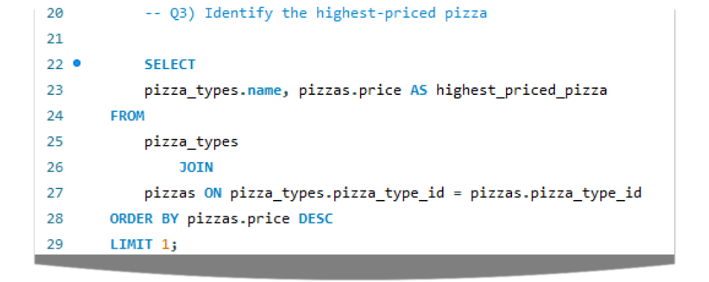
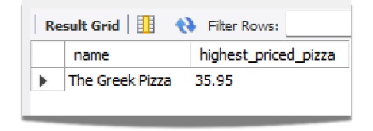
Query 3 – Identify the Highest-Priced Pizza
Result Output:
Insight:
Highlights the premium offering in the product portfolio, useful in pricing strategies and promotions.
PPT by Pabitra Biswas

Slide 7
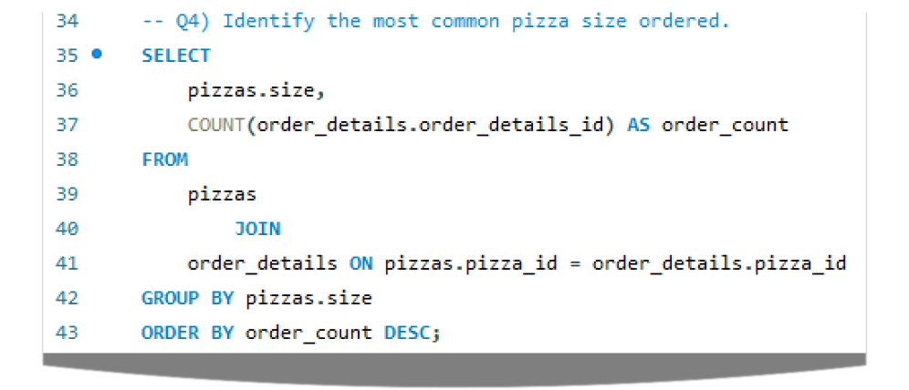
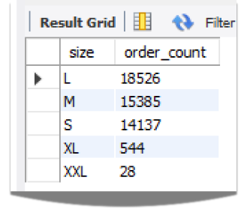
Query 4 – Most Common Pizza Size Ordered
Result Output:
Insight:
Reveals customer preferences and can inform operational decisions such as inventory or targeted marketing.
PPT by Pabitra Biswas

Slide 8
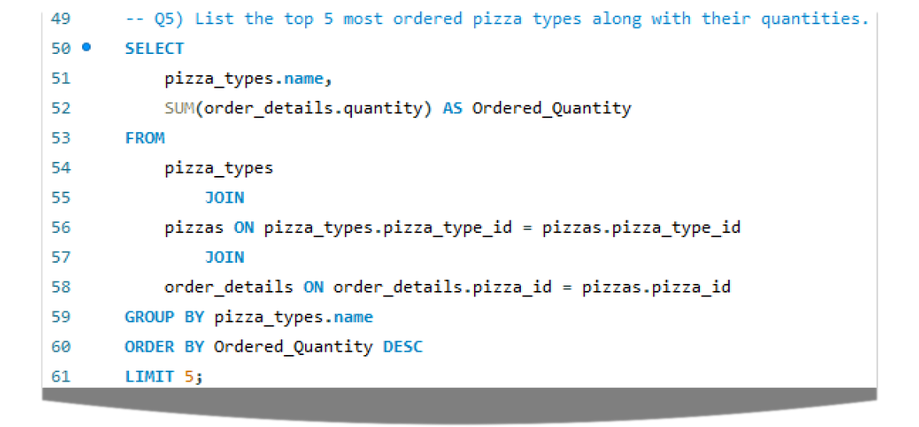
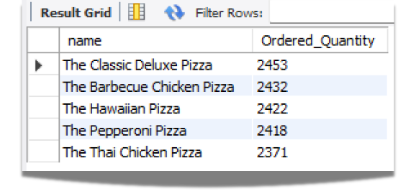
Query 5 – Top 5 Most Ordered Pizza Types (by Quantity)
Result Output:
Insight:
Identifies the most popular pizza types to help in menu optimization and promotional focus.
PPT by Pabitra Biswas

Slide 9
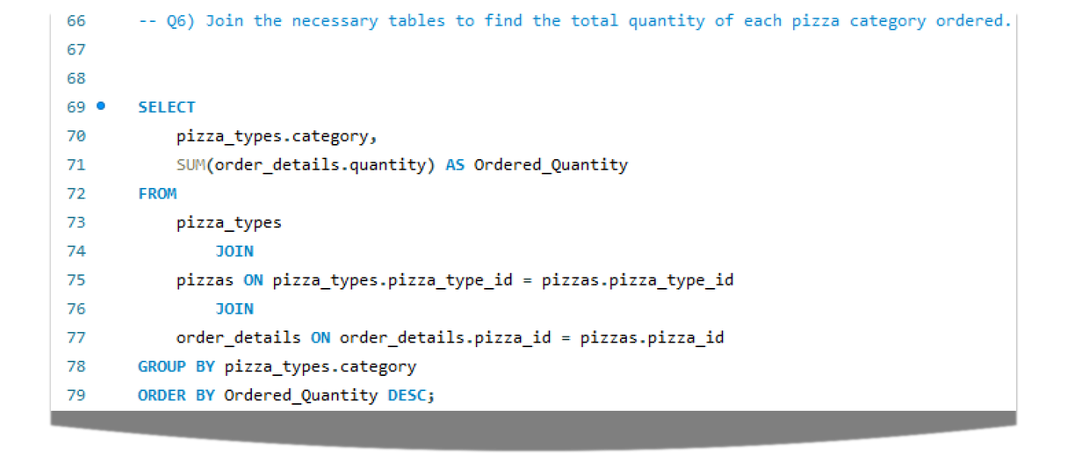
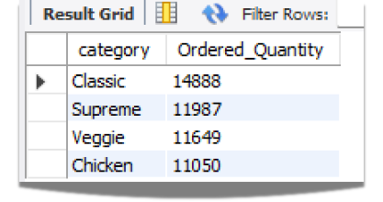
Query 6 – Total Quantity Ordered by Pizza Category
Result Output:
Insight:
Offers a breakdown of sales by category, vital for tailoring category-specific strategies.
PPT by Pabitra Biswas

Slide 10
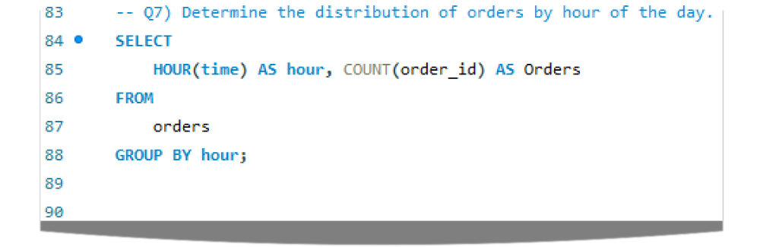
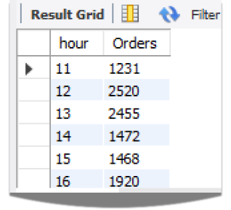
Query 7 – Distribution of Orders by Hour of the Day
Result Output:
Insight:
Provides insights into peak hours for orders, which can drive staffing and promotional decisions.
PPT by Pabitra Biswas

Slide 11
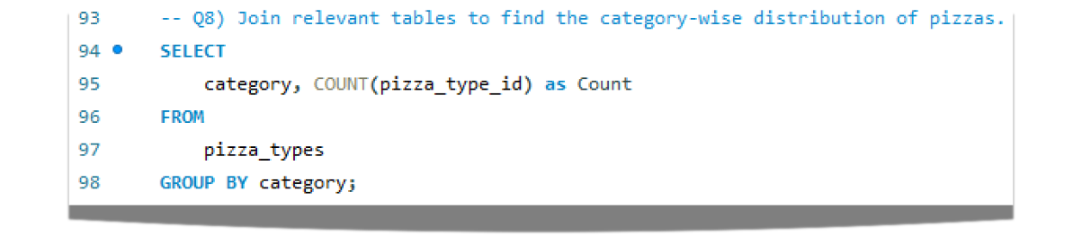
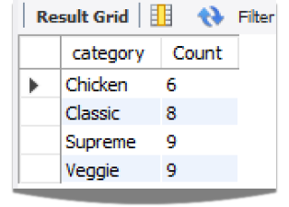
Query 8 – Category-wise Distribution of Pizzas
Result Output:
Insight:
Enhances the understanding of how certain categories perform and directs marketing efforts.
PPT by Pabitra Biswas

Slide 12
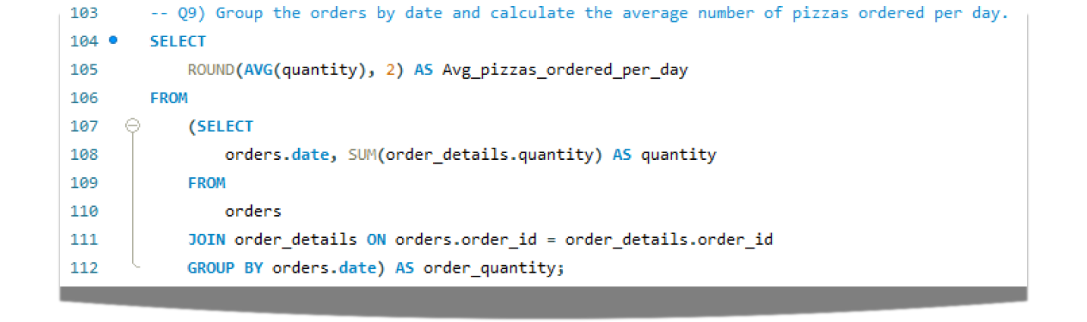
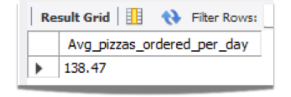
Query 9 – Average Number of Pizzas Ordered per Day
Result Output:
Insight:
Sheds light on daily performance trends.
PPT by Pabitra Biswas

Slide 13
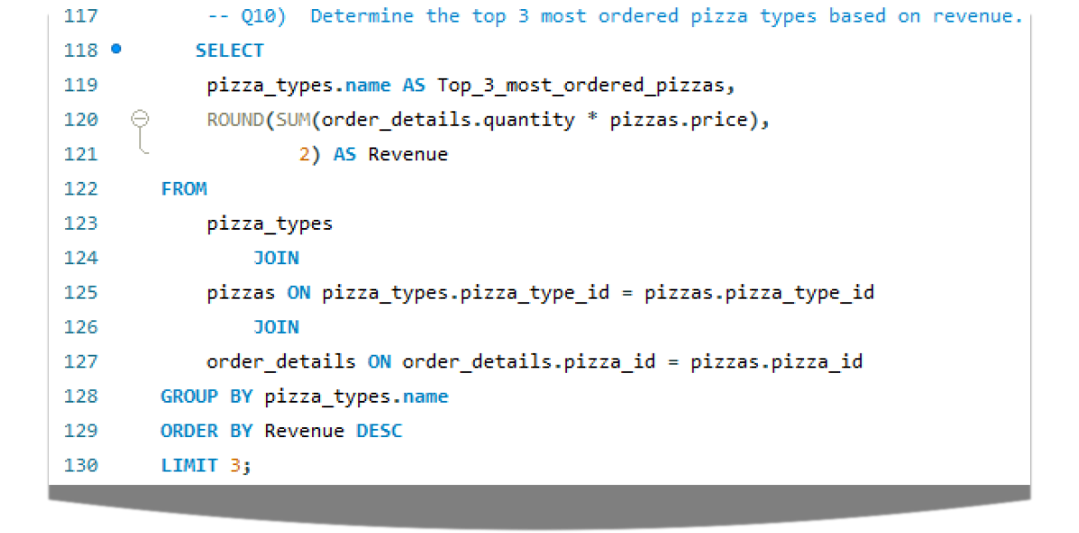
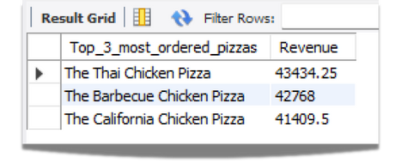
Query 10 – Top 3 Most Ordered Pizza Types Based on Revenue
Result Output:
Insight:
Identifies high-revenue products, crucial for revenue-driven optimization.
PPT by Pabitra Biswas

Slide 14
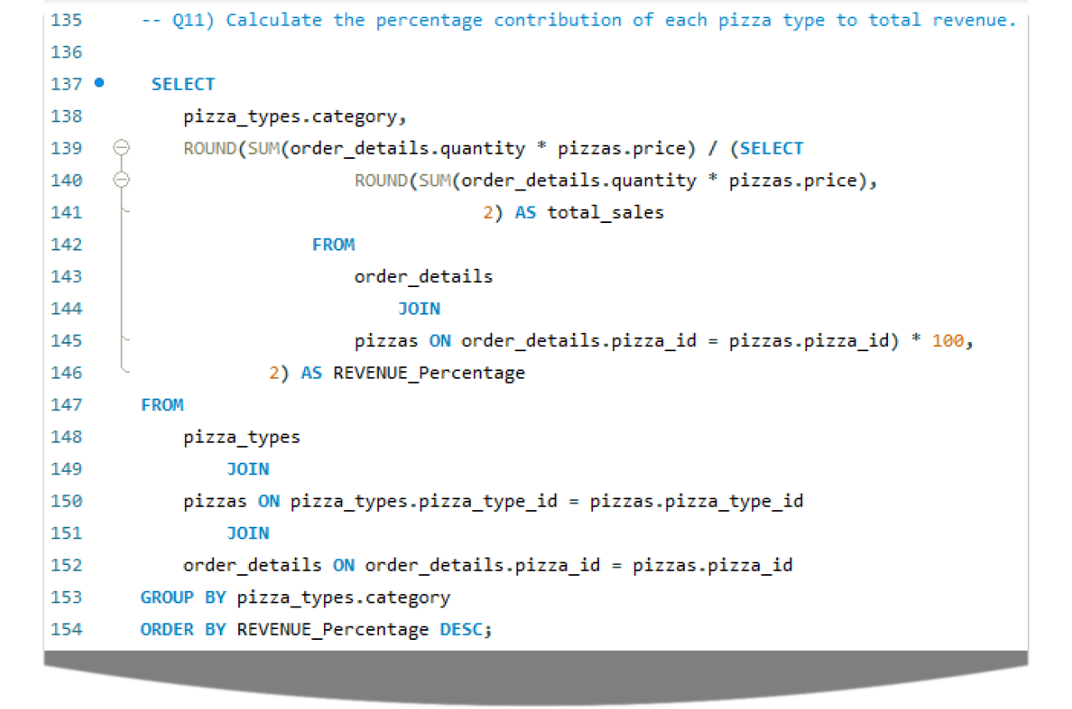
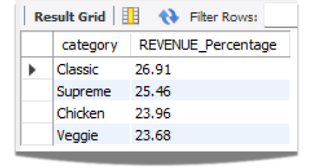
Query 11 – Percentage Contribution of Each Pizza Type to Total Revenue
Result Output:
Insight:
Highlights the revenue impact of each product, essential for resource allocation and strategy.
PPT by Pabitra Biswas

Slide 15
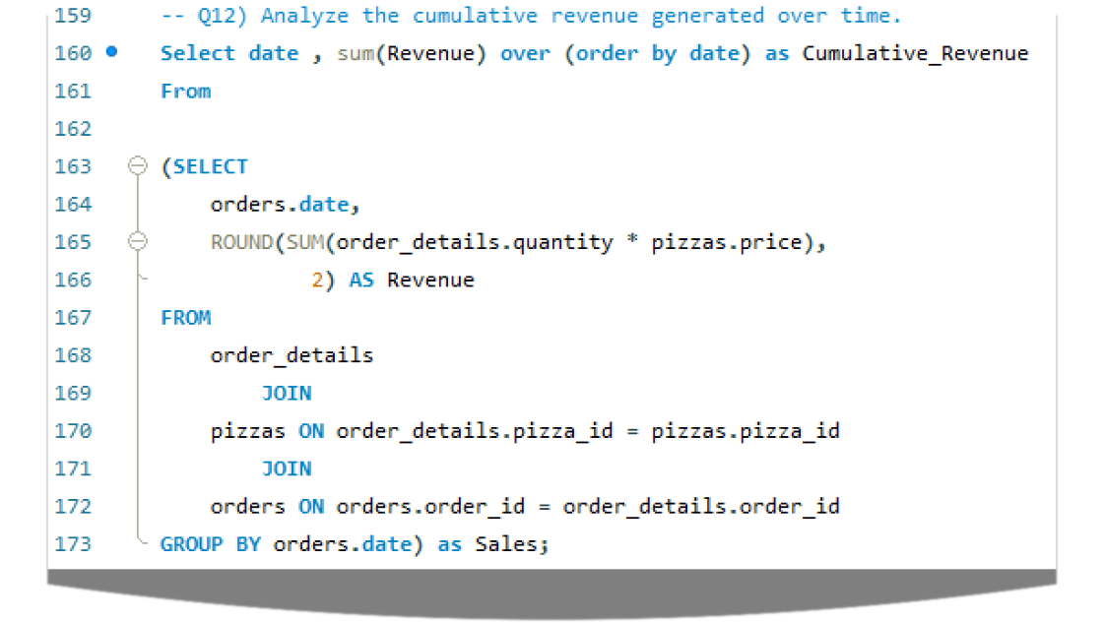
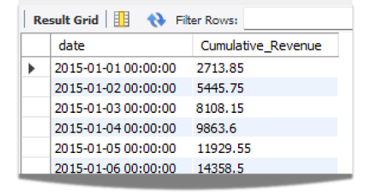
Query 12 – Cumulative Revenue Generated Over Time
Result Output:
Insight:
Illustrates revenue trends and growth trajectories over defined periods.
PPT by Pabitra Biswas

Slide 16
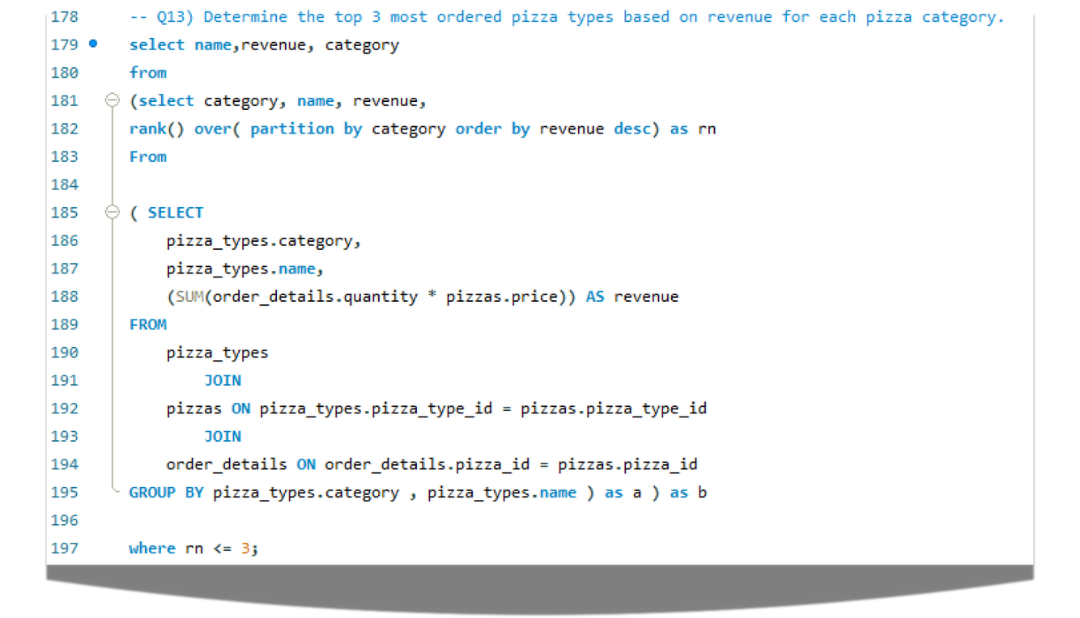
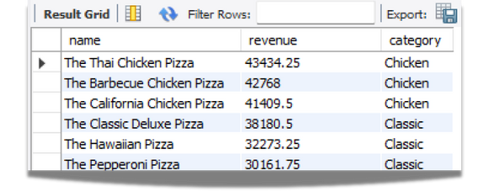
Query 13 – Top 3 Most Ordered Pizza Types by Revenue for Each Category
Result Output:
Insight:
Provides a nuanced view by category, allowing for targeted category-specific strategies.
PPT by Pabitra Biswas

Slide 17

Conclusion & Key Takeaways
Summary of Findings:
Total orders and revenue figures provide a baseline performance metric.
Analysis reveals customer preferences—perfect for promotional strategy adjustments.
Critical products (by quantity &revenue) have been identified.
Time-based & category-specific trends create actionable business insights.
Implications for the Pizza Shop:
Optimize operations during peak periods.
Adjust inventory and marketing based on popular sizes and types.
Explore opportunities to upscale premium offerings.
PPT by Pabitra Biswas

Slide 18
THANK YOU!
PPT by Pabitra Biswas

